Slide 1
MSU CRIS Emerging Issues Committee
Operating Framework, Research Principles & Committee Processes

Slide 2
EIC Operating Framework
EIC Call to Membership*
EIC Bi-Monthly Meeting Agenda
EIC Meeting Results
Research & communication proposals requested in advance of EIC meetings
Research and communications efforts informed by CRIS Social Scanning
Presentation of any Research Proposals
Review Results of Call to Membership
EIC Member Proposals
EIC Research Prioritization (See Decision Criteria)
EIC Communication Proposals & Prioritization (See Decision Criteria)
Draft Study Design Review (See Operating Principles & Decision Criteria)
Other TBD as needed
Meeting Minutes Published
New opportunities
Summary of project recommendations
Study design feedback
Other actions items
Recommendations to CRIS Director for project approval & communication to membership
*TEMPLATE to be developed. Should include problem statement & goal; references

Slide 3
Operating Principles for CRIS Research
Reduce Undue Industry Influence on the CRIS Research Agenda
Balance the industry EIC membership with representatives from academia, NGOs, and regulatory agencies.
Document & publish EIC decision criteria used to identify the CRIS research agenda.
The principal investigator at CRIS or a CRIS partner retains study design ownership.
The CRIS EIC, EAC, or ad hoc experts may provide input and feedback on a study design proposal, but are not in a position to directly update, edit or otherwise influence the final study design or conduct.
Avoid the Use of Animal Testing Whenever Possible
CRIS supports the principles of the 3Rs- Reduce, Refine, and Replace- in toxicological testing using animals.
Publish the EIC process & decisions.
Comments on a research proposal or study design are to be documented & published.
CRIS researchers shall abide by MSU’s animal care program when conducting any necessary research using animals.
CRIS researchers are directed to preferentially use non-animal models where appropriate and possible.
Once a study commences, results are not discussed or shared with CRIS membership until after publication. High level updates on the progress of the research will be shared as part of CRIS business meetings or newsletters.
Recuse CRIS members from influence or voting on research proposals submitted by that member.
Maintain the Integrity of Scientific Research

Slide 4
CRIS Research Initiatives
Membership or Partners
CRIS Committees
CRIS
Social Scan
Inputs
Prioritization of Research Proposals & Study Design
EIC Meetings & Decision Criteria
EIC Meeting Minutes & Study Design Drafts
CRIS Annual meeting presentations
Final study protocols posted online
Publication & posting of final results
Communication of Research
CRIS Project approvals
CRIS Director

Slide 5
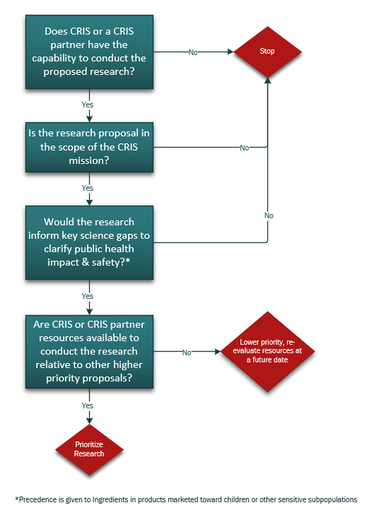
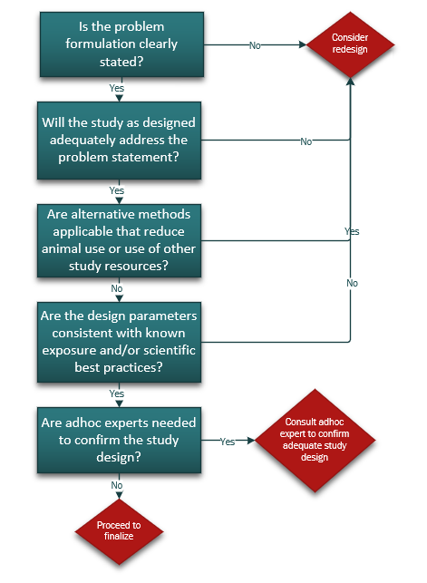
EIC Decision Criteria for Prioritization of CRIS Research Initiatives
Research Proposal
Study Design

Slide 6
CRIS Communications Initiatives
Inputs
Membership or Partners
CRIS Committees
CRIS Social Scan
URGENT
Not Urgent
Call to CRIS Director
-Form ad hoc Committee
-CRIS Communication
-Ad hoc experts
EIC Proposal
EIC Prioritization
2-3 days
3-4 weeks
Develop Strategy
Develop Strategy
Develop Communication
Develop Communication
CRIS Risk Communication
CRIS Risk Communication

Slide 7
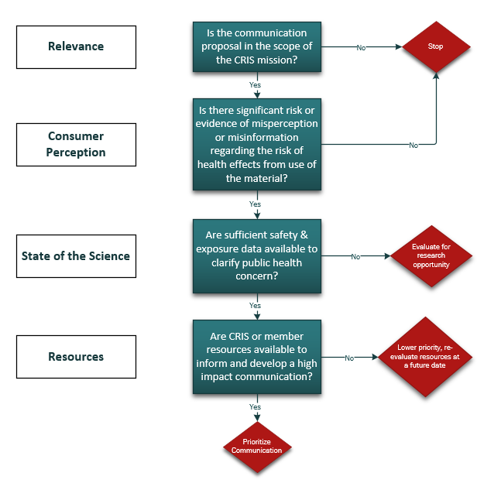
EIC Decision Criteria for Prioritization of CRIS Communication Initiatives

